Slide 1
ACPS Culturally Responsive Teaching Model
In Action

Slide 2
CRT Model Statement of Purpose
To impact student achievement through the facilitation of professional learning opportunities and continued collaboration & coaching of instructional staff.
To produce evidence-based results leading to equitable outcomes for ALL students in ACPS.
To continuously grow, develop, and sustain leadership in Culturally Responsive Teaching

Slide 3

ACPS CRT Model for Continuous-Growth
develop
GROW
CRT Professional Development Series
CRT Micro-Credential Process
Module 1: Recognizing Cultural Lens
Module 2: Engaging Diverse Learners
Module 3: Building Learning Partnerships with Diverse Families
Focus on Teacher CRT Practice & Mindset
Instructional Coaching
Cohort-Supported
Certification Recipients Become Facilitators/Mentors
CRT Certification Process
Cohort model
Individualized coaching
Portfolio Development
Diversity Conference Presentation
Trainer Training
Co-Facilitation of PD Series
School & Division Leadership
sustain
Notes:
Leilani- CRT Professional Development process overview (5 mins)
Now we are moving from the why to the how. Our certification model began in its earliest stages with the identification of three characteristics of Culturally Responsive Teaching. We used these characteristics to create three modules in what we called a CRT Professional development series.
Our hope was and continues to be that all of our educators will go through all three modules to have a foundational knowledge of the three characteristics of CRT. To date, nearly 400 teachers and administrators have gone through the series.
At the end of the PD, educators are given information about the certification process and several have self-selected to participate in the process. Currently, our certification process takes place in a cohort model. The certification cohort meets once per month and is facilitated by a certified educator. The educator also provides indivdualized coaching to the participants. This is an area where we also are growing in. We would like even more individual attention for our certification candidates.
In May of the last two years, an assessment team comprised of university professors, researchers, administrators, and certified teachers have come together to listen to portfolio presentations and assess based on a common rubric. Those who meet the certification requirements are awarded with certificates at our annual diversity conference and also present their evidence for certification at that event.
Our hope is that all of our certification recipients will then become facilitators of our PD Series, thus igniting the process for other educators in our division.

Slide 4
Overview of Results (2016-18)
500+ staff trained in 3 modules of Culturally Responsive Teaching
17 Educators certified in Culturally Responsive Teaching, including:
  1 Gifted Resource Teacher
  2 Instructional Coaches
  6 Administrators
13 Educators Micro-Credentialed in Culturally Responsive Teaching
  12 teachers, 1 instructional coach
Growing Momentum: Seeing the Need & Benefit of CRT Work
  42 Educators Applying for CRT Certification this year & Follow-up coaching
  30 Educators Applying for Micro-Credential in CRT this year & Follow-up coaching
  Shift to Cohort Model to support the work
  14 Administrators working within the Admin for Equity Cohort
10+ Schools focused on CRT Professional Development
Notes:
Lars

Slide 5
Focus of Equity Education Specialists 2018-2019
Diversity Resource Team
Equity Teams
Culturally Responsive Teaching Professional Development
CRT Summer Institute
Micro-Credential in Culturally Responsive Teaching
Certification in Culturally Responsive Teaching
Whole School Embedded CRT PD
Instructional Coaching for Equity
Equity Team Cohorts
Notes:
Lars

Slide 6
Whole School Embedded CRT Professional Development
Cale Elementary School
Year 1: All faculty trained & optional book study of CRT & The Brain
Year 2: All staff CRT focused retreat, embed PD into monthly staff meetings, TPA focus
Support for Certification and Micro Candidates
Woodbrook Elementary School
All faculty trained in CRT, TPA focus
Plan for Teaching Assistants
Full-staff CRT & The Brain Book Study
Support for Certification and Micro Candidates
Notes:
Leilani

Slide 7
Results from Whole School Embedded PD: Cale
2 administrators CRT Certified in SY 17-18
3 Teachers CRT Certified in SY 17-18
10 Teachers awarded micro-credentials in SY 17-18
50+ instructional staff trained in CRT + Ongoing CRT Focused PD
Method of accountability built into TPA Evaluation
10 Teachers coached and supported through certification process in SY 18-19
Results from Whole School Embedded PD: Woodbrook
2 administrators and 10 teachers coached & supported through certification and Micro-Credential processes in SY 18-19
60+ staff, as well as TAs, trained in CRT + Ongoing CRT Focused PD
All staff TPA focused on Culturally Responsive Teaching
Notes:
Leilani

Slide 8
Results from Whole School Embedded PD
READING DATA 2017-18 Upper Elementary | CRT-Engaged Team (Both teachers are CRT Certified) | Mixed Team (One teacher CRT Micro-Credentialed, One unengaged) | Unengaged Team
SOL PASS- White | 86% | 68% | 76%
SOL PASS- Hispanic | 42% | 13% | 14%
SOL PASS- Black | 100% | 50% | 50%
SOL PASS- Multi | 100% | 100% | 100%
SOL PASS-SPED | 50% | 50% | 0
TOTAL PASS RATE | 67% | 60% | 62%
SOL GROWTH- White | 93% | 74% | 82%
SOL GROWTH- Hispanic | 63% | 38% | 29%
SOL GROWTH- Black | 100% | 50% | 50%
SOL GROWTH- Multi | 100% | 100% | 100%
SOL GROWTH- SPED | 75% | 63% | 75%
TOTAL GROWTH RATE* | 79% | 69% | 68%
*Student growth is determined by comparing the student’s test score in the current year to his/her prior test score. This method of determining student progress is used by the VDOE in determining school accreditation starting in the 2018-19 school year. For more information see this presentation on using Progress Tables to Measure Student Growth, VDOE.

Slide 9
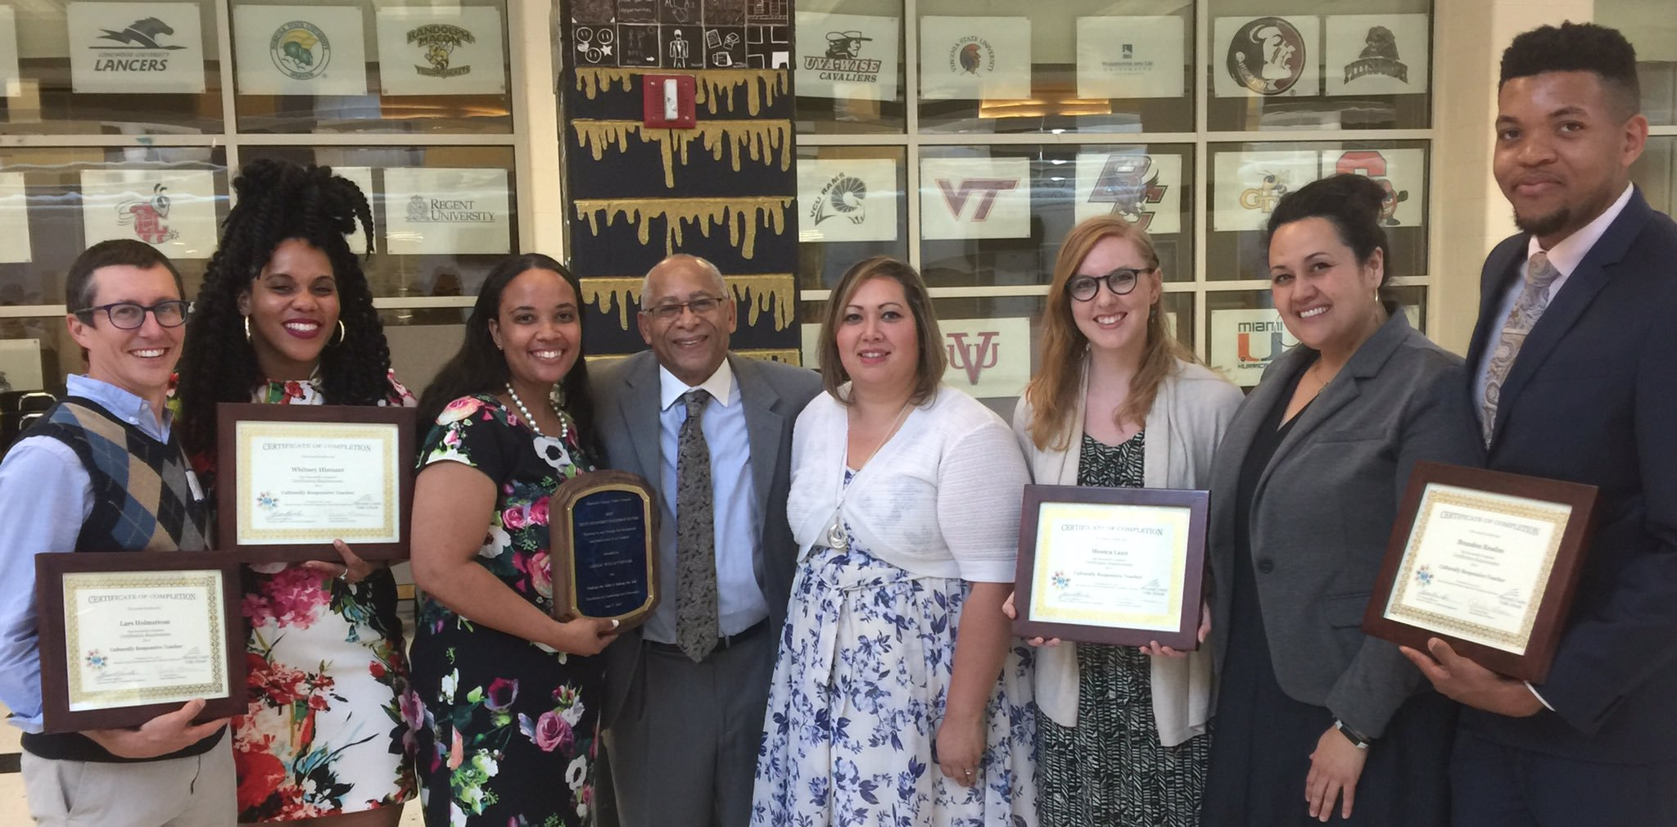
Certification in Culturally Responsive Teaching
Year-long, Cohort-Supported Process
Focused on the Application of CRT Characteristics
Student Achievement Results, Evidence-based portfolios
Culminates in Certification Presentations by assessment panel
Certification results connected to ACPS Strategic Priorities
Notes:
Lars

Slide 10
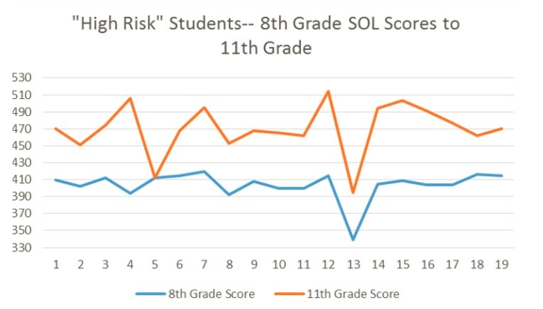
Results from Certification in Culturally Responsive Teaching
This CRT Certified Teacher:
Addressed Implicit Bias in Instructional Practices and built strong culture- informed learning partnerships with individual students
Shifted personal mindset to expect different outcomes for students labeled “high risk.”
Notes:
Lars: Narrate through box on right, be sure to connect to CRT #1 and #2

Slide 11
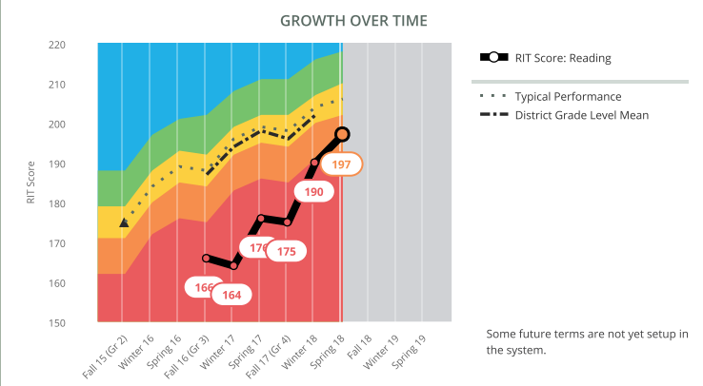
Sample results
from Micro-cred
Educator
“All of the students that made more than 14 points of growth had observed growth that surpassed their projected growth on this assessment. I certainly cannot take credit for all of this excellent progress, but I believe the CRT training program can! The educators that I co-teach with have also participated in our school’s Culturally Responsive Teacher training, and I feel that our students have truly benefited from our continuing education.”

Slide 12
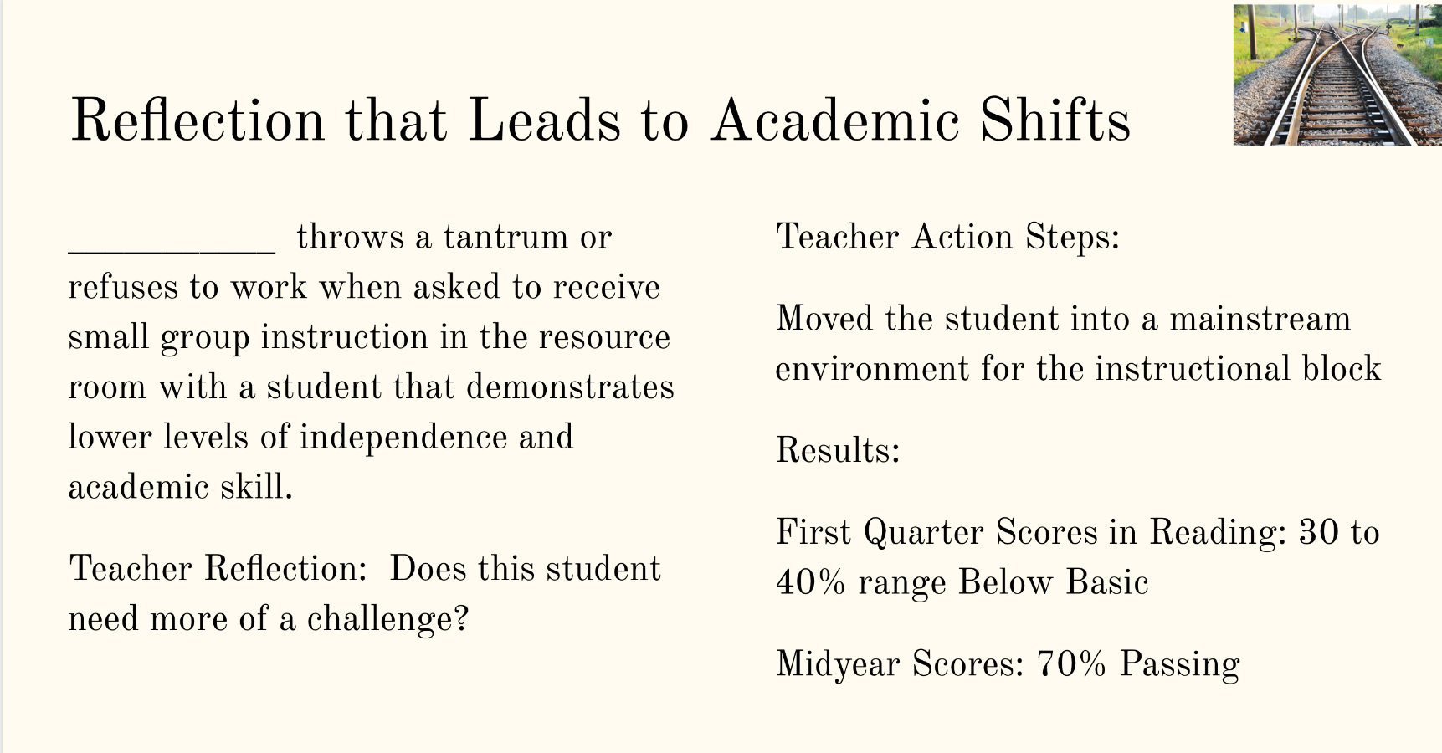
Results from Certification in Culturally Responsive Teaching
This CRT Certified Teacher:
Shifted mindset to expect a better outcome for a student who was considered a “behavioral challenge”
Increased the student’s achievement by removing a systemic barrier to success, in this case the intervention service
Notes:
Lars - narrate through the importance of the relationship that she built with this students that allowed her to partner around high expectations and high levels of success.

Slide 13
Increase in Demand for CRT
Requests for Professional Development
12+ schools requesting Professional Development Support or Facilitation in CRT:
Woodbrook Elementary
Agnor-Hurt Elementary
Cale Elementary
Scottsville Elementary
Stony Point Elementary
Meriwether Lewis Elem
Albemarle High
Western Albemarle High
Monticello High
Jouett Middle
Burley Middle
Walton Middle
Certification & Micro-Credential Candidates
Candidates for Certification
2015-16 6
2016-17 6
2017-18 9
2018-19 42
CRT Micro-Credential Applicants
2017-18 13
2018-19 34
Diversity Resource Team Attendance
Attendance at DRT Meetings 2016-17
30 average
Attendance at DRT Meetings 2017-18
40 average
Attendance at DRT Meetings 2018-19
80 average
Notes:
Leilani

Slide 14
Supporting Growth, Expanding Equity Outcomes
Professional Development
Required modular training for all instructional staff & all Admin; TPA Evaluation to include CRT indicators
Supporting Certification & Micro Candidates
Broaden Cohort Model to serve feeder patterns; Increase opportunities for individualized coaching support
Diversity Resource Team
Strengthen & support Equity Teams; Support DRTs to influence Equity work at schools; Expand Diversity Conference
Equity Education Specialists
Expand Equity Specialist team to meet needs; Bring new equity learning to our community
Summer PD
Summer Professional Development focus for all staff on Cultural Awareness with differentiated approach
Collaboration with Instructional Coaching Model
Collaborate with Instructional Coaches to support Micro-Credential Applicants
Notes:
Leilani

